Slide 1
COURSE: PHY 111 UNITS: THREE (3) LECTURER: MR KAMAL MUHAMMAD GONTO
CONTENTS
CIRCULAR MOTION
GRAVITION
ELASTICITY

Slide 2
CIRCULAR MOTION
Circular motion is described as a movement of an object while rotating along a circular path.
Circular motion can either be UNIFORM or NON – UNIFORM
Examples of circular motion
A rotating ceiling fan
Man-made satellite that revolve around the earth
a moving car wheels

Slide 3

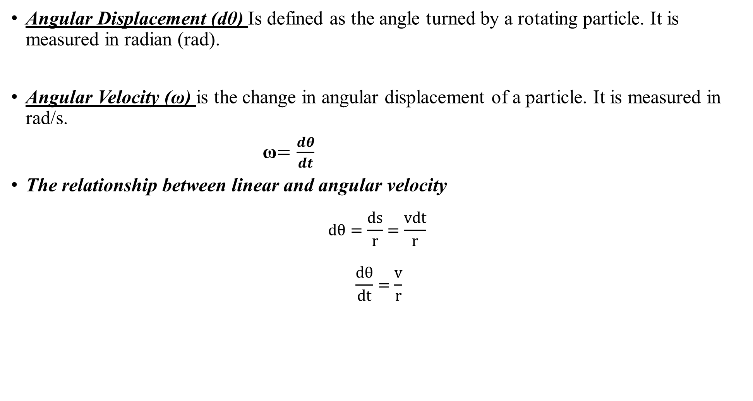
Angular Variables
Angular Displacement (dθ) Is defined as the angle turned by a rotating particle. It is measured in radian (rad).
Angular Velocity (ω) is the change in angular displacement of a particle. It is measured in rad/s.
ω$=\frac{dθ}{dt}$
The relationship between linear and angular velocity
$$dθ=\frac{ds}{r}=\frac{vdt}{r}$$
$$\frac{dθ}{dt}=\frac{v}{r}$$
$$ω=vr$$

Slide 4
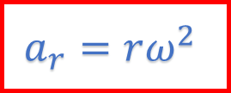
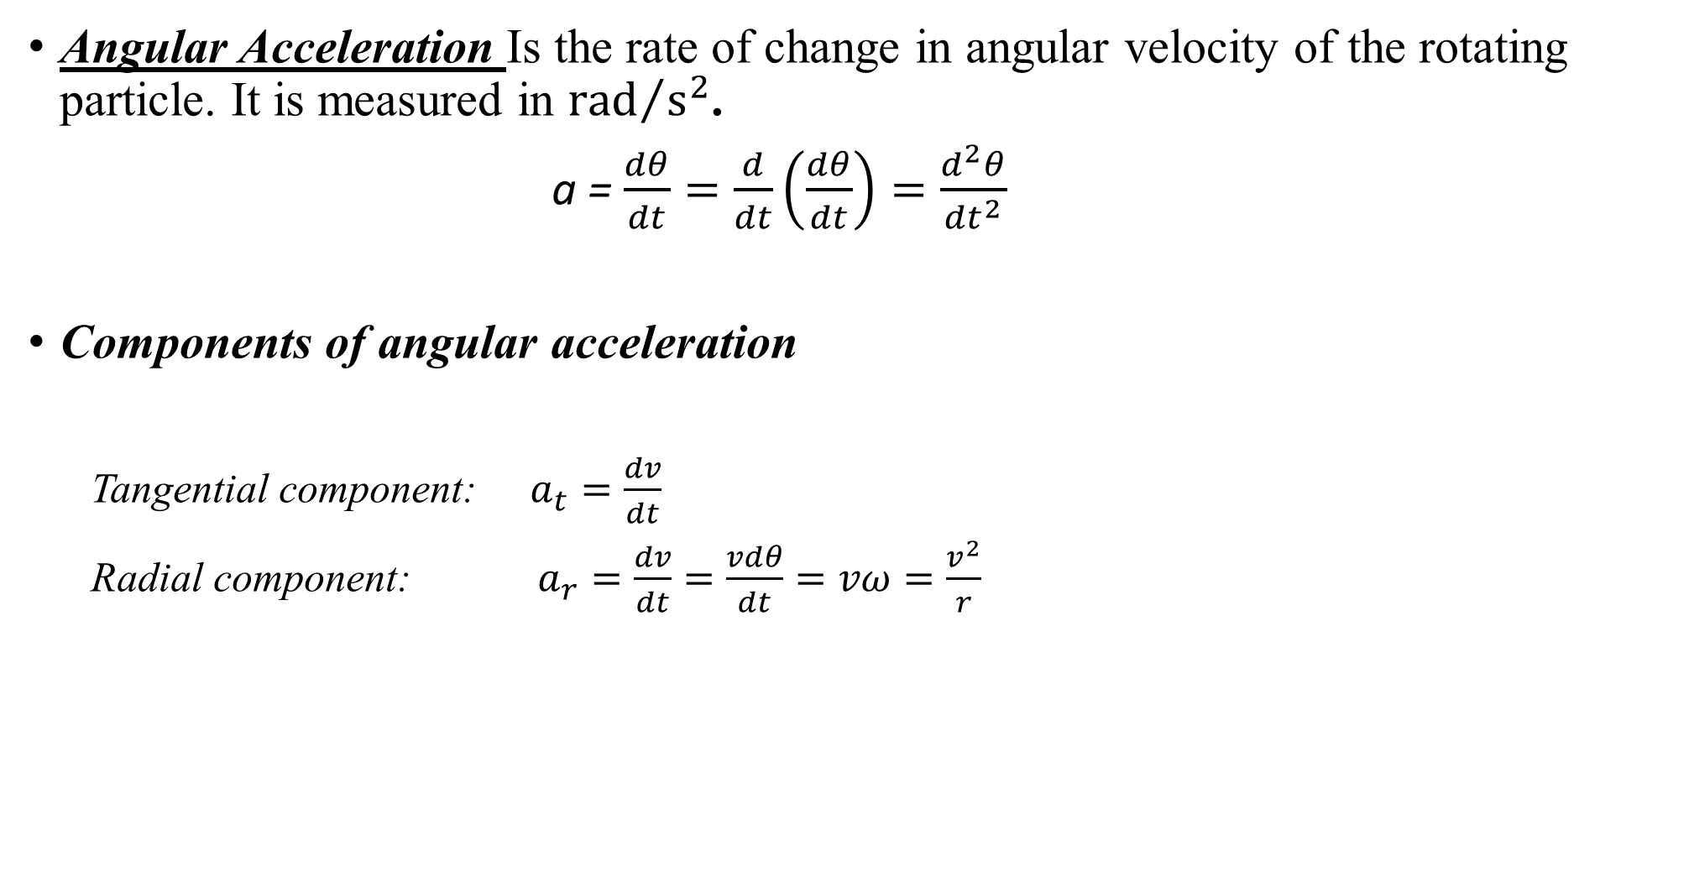
Angular Acceleration Is the rate of change in angular velocity of the rotating particle. It is measured in ${rad}/{s^{2}}$.
a = $\frac{dθ}{dt}=\frac{d}{dt}\left(\frac{dθ}{dt}\right)=\frac{d^{2}θ}{{dt}^{2}}$
Components of angular acceleration
Tangential component: $a_{t}=\frac{dv}{dt}$
Radial component: $a_{r}=\frac{dv}{dt}=\frac{vdθ}{dt}=vω=\frac{v^{2}}{r}$
$$a_{r}=rω^{2}$$

Slide 5
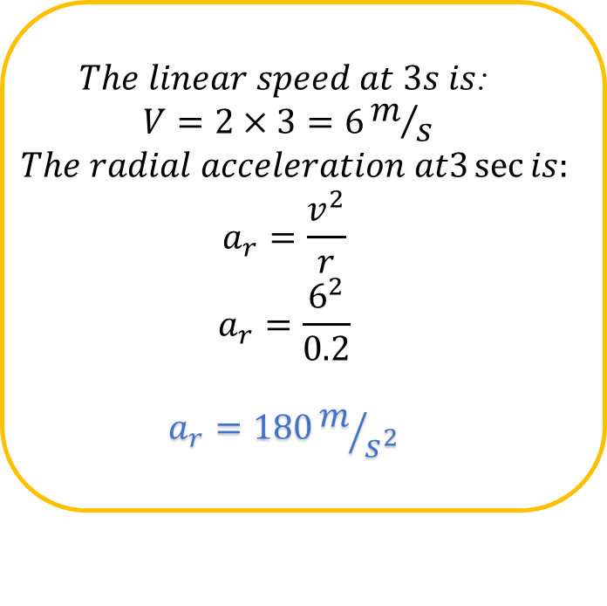


Example 1
A particle moves in a circle of radius 20cm. Its linear speed at any time is given by $v=2t where v is in m/s and t is in sec.$Find the radial and tangential acceleration at $t=3s.$
Soln: $r=20cm=0.2m$
$The linear speed at 3s is$:
$$V=2×3=6m/s$$
$$The radial acceleration at3\sec{is:}$$
$$a_{r}=\frac{v^{2}}{r}$$
$$a_{r}=\frac{6^{2}}{0.2}$$
$$a_{r}=180m/{s^{2}}$$
$$The tangentail acceleration is:$$
$$a_{t}=\frac{v}{t}$$
$$a_{t}=\frac{2t}{t}$$
$a_{t}=2m/{s^{2}}$

Slide 6
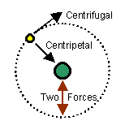


Centripetal and Centrifugal Forces
Centripetal and Centrifugal forces are the forces experienced by rotating objects.
Centripetal force keeps an object moving in a circle and it is always pointed toward the center of the circle.
Centrifugal force is an apparent outward force on an object that is moving in a circle.
$$F=ma :a=\frac{v^{2}}{r}$$
$$F=\frac{{mv}^{2}}{r} : ω=\frac{v}{r}$$
$$F=mω^{2}v$$

Slide 7
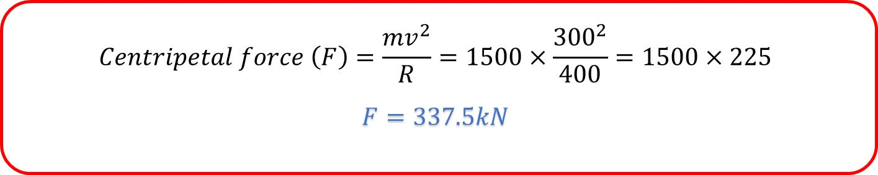
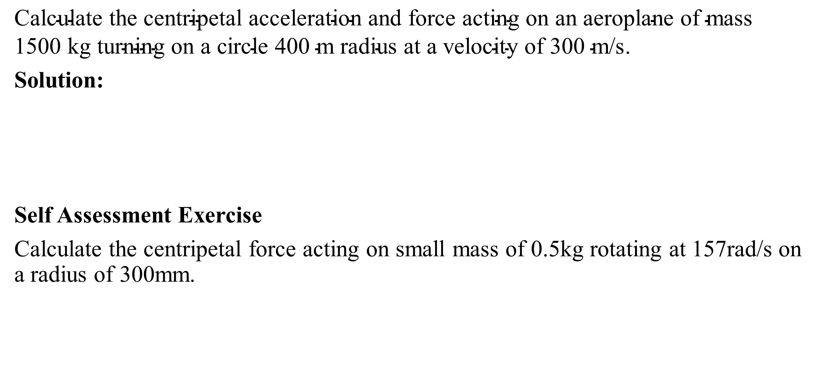

Example2
$\text{Calculate} \text{the} \text{centripetal} \text{acceleration} \text{and} \text{force} \text{acting} \text{on} \text{an} \text{aeroplane} \text{of} \text{mass}\text{ 1500 }\text{kg} \text{turning} \text{on} \text{a} \text{circle}\text{ 400 }\text{m} \text{radius} \text{at} \text{a} \text{velocity} \text{of}\text{ 300 }\text{m}\text{/}\text{s}$.
Solution:
Self Assessment Exercise
Calculate the centripetal force acting on small mass of 0.5kg rotating at 157rad/s on a radius of 300mm.
$$Centripetal force \left(F\right)=\frac{{mv}^{2}}{R}=1500×\frac{{300}^{2}}{400}=1500×225$$
$$F=337.5kN$$
$$Ans=3697N$$

Slide 8
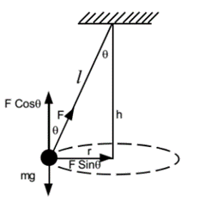
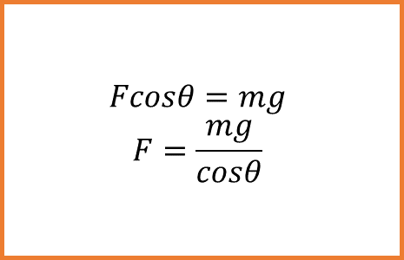
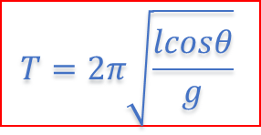
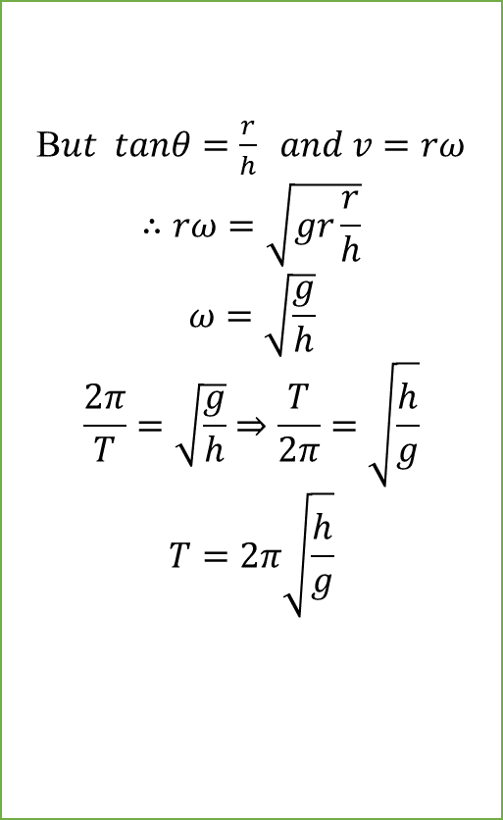

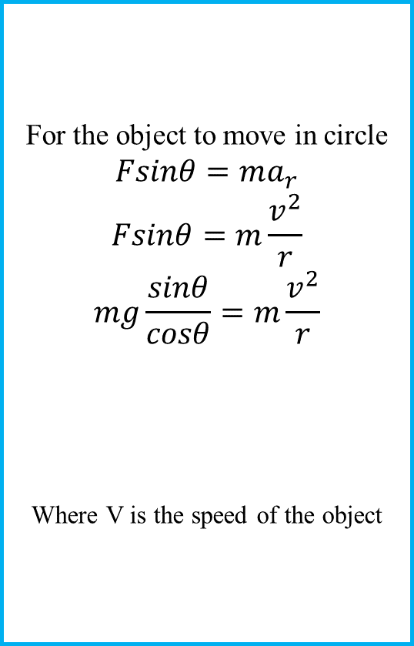
Conical Pendulum
For the object to move in circle
$$Fsinθ=ma_{r}$$
$$Fsinθ=m\frac{v^{2}}{r}$$
$$mg\frac{sinθ}{cosθ}=m\frac{v^{2}}{r}$$
Where V is the speed of the object
B$ut tanθ=\frac{r}{h} and v=rω$
$$∴rω=\sqrt{gr\frac{r}{h}}$$
$$ω=\sqrt{\frac{g}{h}}$$
$$\frac{2π}{T}=\sqrt{\frac{g}{h}}⇒\frac{T}{2π}=\sqrt{\frac{h}{g}}$$
$$T=2π\sqrt{\frac{h}{g}}$$
$$v=\sqrt{grtanθ}$$
$$Fcosθ=mg$$
$$F=\frac{mg}{cosθ}$$
$$T=2π\sqrt{\frac{lcosθ}{g}}$$

Slide 9
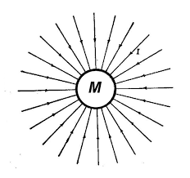
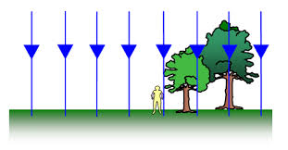
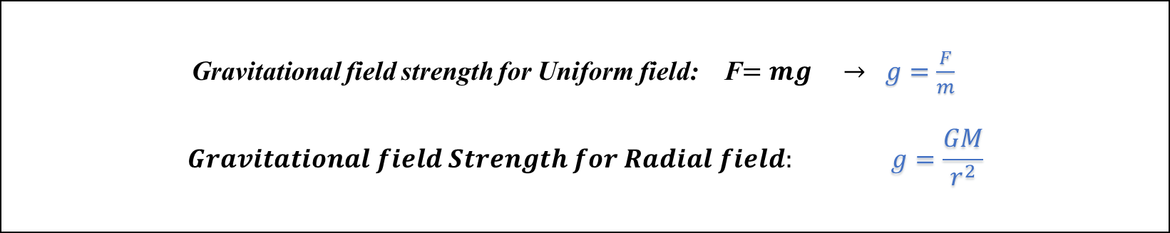
Gravitational Field
Gravitational field is an area where objects with mas experience a non-contact force.
Types of gravitational field
Gravitational field strength (g) is the force per unit mass exerted by a gravitational field on an object.
Radial field
Uniform field
Gravitational field strength for Uniform field: F$=mg → g=\frac{F}{m}$
$$Gravitational field Strength for Radial field: g=\frac{GM}{r^{2}}$$

Slide 10








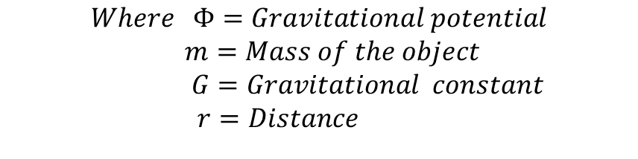
Newton’s Law of Universal Gravitation
The law states that the gravitational force between two masses is directly proportional to the product of the masses, and is inversely proportional to the square of the distance between them
Gravitational Potential (ɸ) is the workdone per unit mass when moving a small point mass from infinity to that point.
Escape Velocity is the minimum velocity required by a body to be projected to overcome the gravitational pull of the earth.
$$F_{1}$$
$$F_{2}$$
$$m_{1}$$
$$m_{2}$$
$$F=\frac{Gm_{1}m_{2}}{r^{2}}$$
$$r$$
$$Φ=−\frac{Gm}{r}$$
$$Where Φ=Gravitational potential$$
$m=Mass of the object$
$G=Gravitational constant$
$r=Distance$
$$V_{esc}=\sqrt{\frac{2Gm}{R}}$$

Slide 11

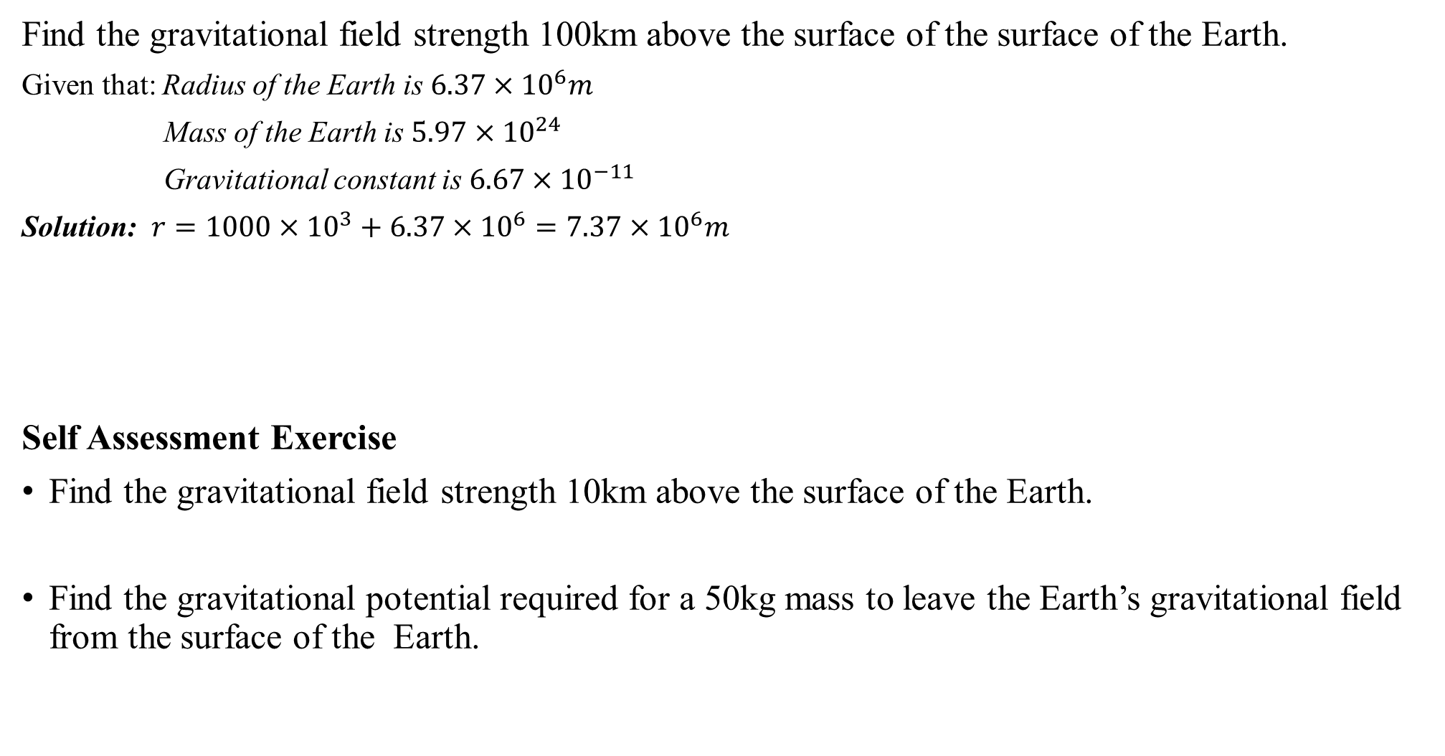

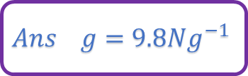
Example 3
Find the gravitational field strength 100km above the surface of the surface of the Earth.
Given that: Radius of the Earth is $6.37×{10}^{6}m$
Mass of the Earth is $5.97×{10}^{24}$
Gravitational constant is $6.67×{10}^{−11}$
Solution: $r=1000×{10}^{3}+6.37×{10}^{6}=7.37×{10}^{6}m$
Self Assessment Exercise
Find the gravitational field strength 10km above the surface of the Earth.
Find the gravitational potential required for a 50kg mass to leave the Earth’s gravitational field from the surface of the Earth.
Gravitational field strength $\left(g\right)= \frac{Gm}{r^{2}}$
g$=\frac{{6.67×10}^{−11}×{5.97×10}^{24}}{{\left({7.39×10}^{6}\right)}^{2}}$
g$={7.3Nkg}^{−1}$
$${Ans g=9.8Ng}^{−1}$$
$$Ans g={−6.25×10}^{7}{Jkg}^{−1}$$

Slide 12


ELASTICITY
The property of a material to regain its original condition on the removal of deforming forces is called elasticity.
Stress and Strain
Stress: is the restoring force or recovering force per unit area set up inside the material.
$$Stress= \frac{Force(F)}{Area (a)}$$
There are two types of stress:
Normal Stress
Tangential Stress
Strain: is the increase in length $∆l$ per original length L of the material.
$$Strain=\frac{∆l}{L}$$
Types of strain
Longitudinal strain$=\frac{change in length (l)}{original length (L)}$
Volume strain$=\frac{change in volume (v)}{original volume (V)}$
Shear strain is the angular deformation produced by an external force θ.

Slide 13
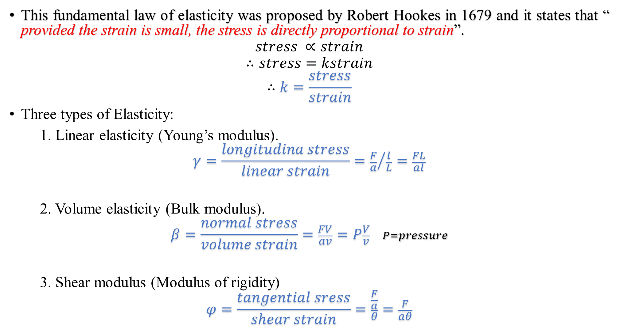
Hooke’s Law
This fundamental law of elasticity was proposed by Robert Hookes in 1679 and it states that “ provided the strain is small, the stress is directly proportional to strain”.
$$stress ∝strain$$
$$∴stress=kstrain$$
$$∴k=\frac{stress}{strain}$$
Three types of Elasticity:
1. Linear elasticity (Young’s modulus).
$$γ=\frac{longitudina stress}{linear strain}={\frac{F}{a}}/{\frac{l}{L}=\frac{FL}{al}}$$
2. Volume elasticity (Bulk modulus).
$$β=\frac{normal stress}{volume strain}=\frac{FV}{av}=P\frac{V}{v} P=pressure$$
3. Shear modulus (Modulus of rigidity)
$$φ=\frac{tangential sress}{shear strain}=\frac{\frac{F}{a}}{θ}=\frac{F}{aθ}$$

Slide 14


Work done per unit volume in case of tangential strain
$$Work done is given by dW=Fdl$$
$$We know that, γ=\frac{FL}{al} ∴ F=\frac{γal}{L}$$
$$∴dW=\frac{γal}{L}dl$$
$$W=\int{\frac{γal}{L}dl}=\frac{γa}{L}\int{l dl}=\frac{γa}{L}\left(\frac{l^{2}}{2}\right)$$
$$W=\frac{1}{2}\frac{γal}{L}×l=\frac{1}{2}F×l$$
$$∴Work done per unit volume=\frac{1}{2}\frac{Fl}{V}=\frac{1}{2}\frac{Fl}{aL}$$
$$=\frac{1}{2}\left(\frac{F}{a}\right)×\left(\frac{l}{L}\right)$$
$$∴Work done per unit volume=\frac{1}{2}×stress×strain$$

Slide 15
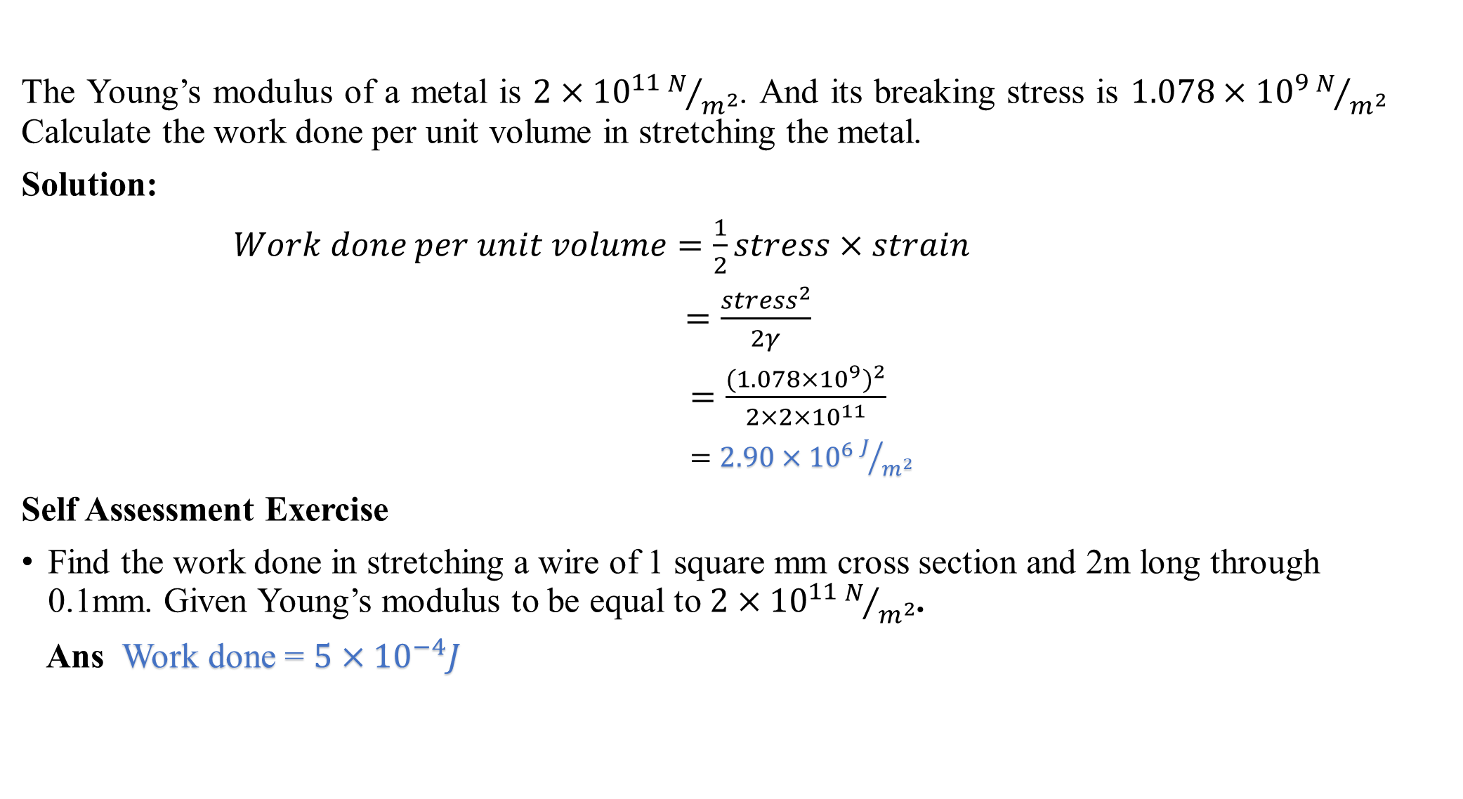
Example 4
The Young’s modulus of a metal is $2×{10}^{11}N/{m^{2}}$. And its breaking stress is ${1.078×10}^{9}N/{m^{2}}$ Calculate the work done per unit volume in stretching the metal.
Solution:
$Work done per unit volume=\frac{1}{2}stress×strain$
$=\frac{{stress}^{2}}{2γ}$
$=\frac{{({1.078×10}^{9})}^{2}}{{2×2×10}^{11}}$
$={2.90×10}^{6}J/{m^{2}}$
Self Assessment Exercise
Find the work done in stretching a wire of 1 square mm cross section and 2m long through 0.1mm. Given Young’s modulus to be equal to $2×{10}^{11}N/{m^{2}}$.
Ans Work done = ${5×10}^{−4}J$

Slide 16
THE END
THANK
YOU
FOR
LISTENING

